Slide 1
Regression comparison

Slide 2
Definitions
Zero dose are those without any doses of DPT or pentavalent vaccines.
If zero_dose is True, it means that the child has received no vaccines and vice-versa.

Slide 3
Sampling approaches
The library used for the sampling approach is imblearn.
The first four rows have been undersampled by randomly picking samples from the majority class till it has reached the same size as the minority class.
The next four rows have been oversampled by picking random samples from the minority class and being repeated with replacement.
The last four rows which use SMOTE algorithm, oversample by creating synthetic data points using the original data points. Using random samples from the minority class, we will identify the KNN(in this case, I have set the value as 3). We will use the vector between this neighbor and the selected data point, multiply with a random value between 0-1, and add this synthetic data point to the minority class.

Slide 4
Notes
The model is trained on 48 attributes, mostly taken from Mira’s recommendations.
The target column is zero dose, which contains kids with no vaccination received for DPT and Penta vaccines.
The oversampling was done on the train data only
Default oversampling and undersampling methods were used from imblearn library(except smote oversampling)

Slide 5
Zero Dose
Total data points : 43,181 (12-23 years) Non-empty data points : 13,137 12,617 False,520 True
Test/Train | Accuracy | Precision | Recall | F1 | Datapoints
No sampling on False datapoint | 0.96 | 0.96 | 1.00 | 0.98 | 3789
No sampling on True datapoint |  | 0 | 0 | 0 | 153
No sampling on False datapoint | 0.96 | 0.96 | 1.00 | 0.98 | 8828
No sampling on True datapoint |  | 0 | 0 | 0 | 367
Undersampling on False datapoint | 0.71 | 0.97 | 0.72 | 0.83 | 3789
Undersampling on True datapoint |  | 0.05 | 0.39 | 0.09 | 153
Undersampling on False datapoint | 0.53 | 0.52 | 0.68 | 0.59 | 367
Undersampling on True datapoint |  | 0.54 | 0.37 | 0.44 | 367
Oversampling on False datapoint | 0.64 | 0.97 | 0.64 | 0.77 | 3789
Oversampling on True datapoint |  | 0.05 | 0.48 | 0.09 | 153
Oversampling on False datapoint | 0.55 | 0.54 | 0.65 | 0.59 | 8828
Oversampling on True datapoint |  | 0.56 | 0.45 | 0.50 | 8828
Oversampling SMOTE on False datapoint | 0.65 | 0.97 | 0.65 | 0.78 | 3789
Oversampling SMOTE on True datapoint |  | 0.05 | 0.49 | 0.10 | 153
Oversampling SMOTE on False datapoint | 0.55 | 0.54 | 0.65 | 0.59 | 8828
Oversampling SMOTE on True datapoint |  | 0.56 | 0.45 | 0.50 | 8828

Slide 6
Zero Dose
Total data points : 43,181 (12-23 years) Non-empty data points : 13,137 12,617 False,520 True
Test/Train | Accuracy | Precision | Recall | F1 | Datapoints
No sampling on True datapoint | 0.96 | 0 | 0 | 0 | 153
No sampling on True datapoint | 0.96 | 0 | 0 | 0 | 367
Undersampling on True datapoint | 0.71 | 0.05 | 0.39 | 0.09 | 153
Undersampling on True datapoint | 0.53 | 0.54 | 0.37 | 0.44 | 367
Oversampling on True datapoint | 0.64 | 0.05 | 0.48 | 0.09 | 153
Oversampling on True datapoint | 0.55 | 0.56 | 0.45 | 0.50 | 8828
Oversampling SMOTE on True datapoint | 0.65 | 0.05 | 0.49 | 0.10 | 153
Oversampling SMOTE on True datapoint | 0.55 | 0.56 | 0.45 | 0.50 | 8828

Slide 7
Sampling breakdown zero dose
 | Dataset | Unsampled Train | Unsampled Test | Undersampling Train | Undersampling Test | Oversampling Train | Oversampling Test | Oversampling Train | Oversampling Test
 |  |  |  |  |  |  |  | SMOTE
False Datapoint | 12617 | 8828 | 3789 | 367 | 3789 | 8828 | 3789 | 8828 | 3789
True Datapoint | 520 | 367 | 153 | 367 | 153 | 8828 | 153 | 8828 | 153

Slide 8
Zero Dose Updated
Total data points : 43,181 (12-23 years) Non-empty data points : 31,457 12,617 False,520 True
Test/Train | Accuracy | Precision | Recall | F1 | Datapoints
No sampling on True datapoint |  | 0 | 0 | 0 | 495
No sampling on False datapoint | 0.95 | 0.95 | 1.00 | 0.98 | 20983
No sampling on True datapoint |  | 0 | 0 | 0 | 1036
Undersampling on False datapoint | 0.53 | 0.96 | 0.53 | 0.68 | 8943
Undersampling on True datapoint |  | 0.06 | 0.56 | 0.11 | 495
Undersampling on False datapoint | 0.57 | 0.57 | 0.53 | 0.55 | 1036
Undersampling on True datapoint |  | 0.56 | 0.60 | 0.58 | 1036
Oversampling on False datapoint | 0.64 | 0.96 | 0.53 | 0.68 | 8943
Oversampling on True datapoint |  | 0.06 | 0.56 | 0.11 | 495
Oversampling on False datapoint | 0.56 | 0.56 | 0.53 | 0.54 | 20983
Oversampling on True datapoint |  | 0.56 | 0.59 | 0.57 | 20983
Oversampling SMOTE on False datapoint | 0.65 | 0.96 | 0.53 | 0.68 | 8943
Oversampling SMOTE on True datapoint |  | 0.06 | 0.56 | 0.11 | 495
Oversampling SMOTE on False datapoint | 0.56 | 0.57 | 0.52 | 0.55 | 20983
Oversampling SMOTE on True datapoint |  | 0.56 | 0.60 | 0.58 | 20983

Slide 9
Zero Dose Updated(weight balanced)
Total data points : 43,181 (12-23 years) Non-empty data points : 31,457 12,617 False,520 True
Test/Train | Accuracy | Precision | Recall | F1 | Datapoints
No sampling on True datapoint | 0.95 | 0 | 0 | 0 | 495
No sampling on True datapoint | 0.95 | 0 | 0 | 0 | 1036
Undersampling on True datapoint | 0.53 | 0.06 | 0.56 | 0.11 | 495
Undersampling on True datapoint | 0.57 | 0.56 | 0.60 | 0.58 | 1036
Oversampling on True datapoint | 0.64 | 0.06 | 0.56 | 0.11 | 495
Oversampling on True datapoint | 0.56 | 0.56 | 0.59 | 0.57 | 20983
Oversampling SMOTE on True datapoint | 0.65 | 0.06 | 0.56 | 0.11 | 495
Oversampling SMOTE on True datapoint | 0.56 | 0.56 | 0.60 | 0.58 | 20983

Slide 10
Zero Dose( No weight balancing)
Total data points : 43,181 (12-23 years) Non-empty data points : 31,457 12,617 False,520 True
Test/Train | Accuracy | Precision | Recall | F1 | Datapoints
No sampling on True datapoint | 0.95 | 0 | 0 | 0 | 495
No sampling on True datapoint | 0.95 | 0 | 0 | 0 | 1036
Undersampling on True datapoint | 0.53 | 0.06 | 0.56 | 0.11 | 495
Undersampling on True datapoint | 0.57 | 0.56 | 0.60 | 0.58 | 1036
Oversampling on True datapoint | 0.53 | 0.06 | 0.56 | 0.11 | 495
Oversampling on True datapoint | 0.56 | 0.56 | 0.59 | 0.57 | 20983
Oversampling SMOTE on True datapoint | 0.53 | 0.06 | 0.56 | 0.11 | 495
Oversampling SMOTE on True datapoint | 0.56 | 0.56 | 0.60 | 0.58 | 20983

Slide 11
Sampling breakdown for zero dose
 | Dataset | Unsampled Train | Unsampled Test | Undersampling Train | Undersampling Test | Oversampling Train | Oversampling Test | Oversampling Train | Oversampling Test
 |  |  |  |  |  |  |  | SMOTE
False Datapoint | 29926 | 20983 | 8943 | 1036 | 8943 | 20983 | 8943 | 20983 | 8943
True Datapoint | 1531 | 1036 | 495 | 1036 | 495 | 20983 | 495 | 20983 | 495

Slide 12
Correlation
 | zero_dose
impr_ws | -0.04242
unimpr_ws | 0.04242
basic_drinking_w | -0.043395
limited_drinking_w | -0.040382
jmp_w8 | -0.02344
jmp_w2 | -0.024067
jmp_w5 | 0.025901
jmp_s1 | 0.025901
jmp_s6 | 0.026042
jmp_s8 | 0.02584
jmp_s7 | 0.009431
jmp_h1 | -0.012574
jmp_h2 | -0.023645
jmp_h3 | -0.013866
wi_combined | -0.065699
wi_combined_score | -0.071786
wi_ur | -0.075311
 | zero_dose
 | zero_dose
wi_ur_score | -0.083747
kaccha_floor | 0.039358
kaccha_roof | 0.034116
kaccha_walls | 0.023638
all_kaccha_house | 0.043673
own_house | -0.011737
own_agri_land | -0.017657
bpl_card | -0.009113
clean_fuel_usage | 0.001979
highest_grade_comp | -0.008698
bank_acc | -0.035244
child_death | nan
other_wives | 0.010162
mcp_card | -0.064949
antenatal_care | -0.134444
antenatal_4plus | -0.087742
tetanus | -0.127702
birth_personnel | -0.01537
icds_rec | -0.117141
icds_rec_bf | -0.11381
w_age_marr | -0.02756
zero_dose | 1
fully_vac | -0.558146
under_vacc | -0.095643
Elevation | 0.006424
LATNUM | 0.031358
LONGNUM | 0.039221
Zero Dose

Slide 13
Correlation
 | under_vacc
impr_ws | 0.001551
unimpr_ws | -0.001551
basic_drinking_w | 0.001551
limited_drinking_w | 0.001551
jmp_w8 | 0.017546
jmp_w2 | -0.005486
jmp_w5 | -0.014751
jmp_s1 | -0.014751
jmp_s6 | -0.009913
jmp_s8 | -0.012242
jmp_s7 | -0.002394
jmp_h1 | -0.009792
jmp_h2 | 0.001022
jmp_h3 | 0.011789
wi_combined | -0.002913
wi_combined_score | 0.003833
wi_ur | -0.008354
wi_ur_score | -0.013896
 | under_vacc
 | under_vacc
kaccha_floor | 0.009382
kaccha_roof | 0.000315
kaccha_walls | 0.027945
all_kaccha_house | 0.023681
own_house | -0.012186
own_agri_land | -0.027863
bpl_card | 0.007546
clean_fuel_usage | nan
highest_grade_comp | 0.010546
bank_acc | -0.019611
child_death | nan
other_wives | -0.004495
mcp_card | -0.043641
antenatal_care | -0.002845
antenatal_4plus | -0.028424
tetanus | -0.031065
birth_personnel | -0.012178
icds_rec | -0.086949
icds_rec_bf | -0.081352
w_age_marr | -0.00831
zero_dose | -0.067565
fully_vac | -0.827269
under_vacc | 1
Elevation | -0.026994
LATNUM | 0.000121
LONGNUM | 0.034614
caste_le | -0.011109
highest_edu_lvl_le | -0.014769
w_religion_le | 0.007762
w_marital_status_le | -0.004107
delivery_place_le | -0.030695
Undervaccinated

Slide 14
Empty Values Counts
Attribute | Missing count
impr_ws | 2244
unimpr_ws | 2244
basic_drinking_w | 2745
limited_drinking_w | 2267
jmp_w8 | 34
jmp_w2 | 2090
jmp_w5 | 2090
jmp_s1 | 2090
jmp_s6 | 2249
jmp_s8 | 2090
jmp_s7 | 2090
jmp_h1 | 0
jmp_h2 | 0
jmp_h3 | 0
Attribute | Missing count
Attribute | Missing count
Attribute | Missing count
wi_combined | 0
wi_combined_score | 0
wi_ur | 0
wi_ur_score | 0
kaccha_floor | 0
kaccha_roof | 0
kaccha_walls | 0
all_kaccha_house | 0
own_house | 0
bank_acc | 8
highest_edu_lvl | 0
w_religion | 502
w_marital_status | 0
other_wives | 530
mcp_card | 4165
antenatal_care | 1827
antenatal_4plus | 0
tetanus | 2750
delivery_place | 307
icds_rec | 0
w_age_marr | 54
zero_dose | 130
fully_vac | 166
under_vacc | 130
Elevation | 277
LATNUM | 0
LONGNUM | 0
own_agri_land | 0
bpl_card | 75
caste | 2078
highest_grade_comp | 1343
icds_rec_bf | 36

Slide 15
Changes to dataset
Clean_fuel_usage had around 23623 missing values,
birth_personnel had around 10,000 missing vals
Removed these two columns and ended with 31,000 datapoints
Removed unimpr_ws because of negative equivalent corr

Slide 16
Class Weights
Two modelling approaches have been taken:
Initially modelled the dataset with equal weights on both the majority and minority classes
In the other approach, we adjust weights inversely proportional to class frequencies in the input data.

Slide 17
Weights of classes after training the model
Check the sheets
Expected an increase in the accuracy in no sampling modelling during weight balancing, but no changes observed

Slide 18
Zero Dose definition
Previous definition was under_vac did not include zero_dose
Now, under_vac_subset includes zero_dose too

Slide 19
Categorical to Binary
Converted a few attributes from numerical categories to one-hot encoded classes.

Slide 20
Updates from May 1st
Note : All the stats are for the age group 12-23 months (inclusive)

Slide 21
Under vacc(weight balanced)
Total data points : 43,181 (12-23 years) Non-empty data points : 31,457 12,617 False,520 True
Test/Train | Accuracy | Precision | Recall | F1 | Datapoints
No sampling on True datapoint | 0.54 | 0.18 | 0.52 | 0.27 | 1525
No sampling on True datapoint | 0.54 | 0.18 | 0.55 | 0.27 | 3372
Undersampling on True datapoint | 0.56 | 0.18 | 0.48 | 0.26 | 1525
Undersampling on True datapoint | 0.54 | 0.54 | 0.50 | 0.52 | 3372
Oversampling on True datapoint | 0.54 | 0.18 | 0.53 | 0.27 | 1525
Oversampling on True datapoint | 0.55 | 0.54 | 0.56 | 0.55 | 18647
Oversampling SMOTE on True datapoint | 0.53 | 0.18 | 0.52 | 0.27 | 1525
Oversampling SMOTE on True datapoint | 0.55 | 0.55 | 0.56 | 0.55 | 18647

Slide 22
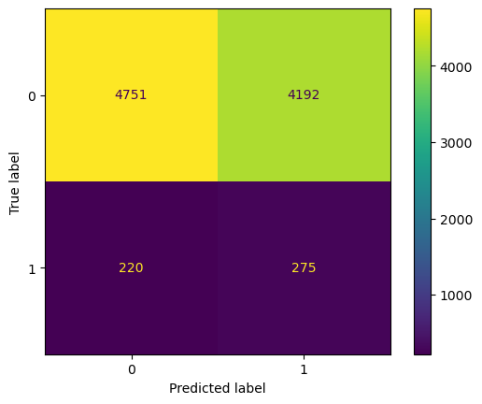
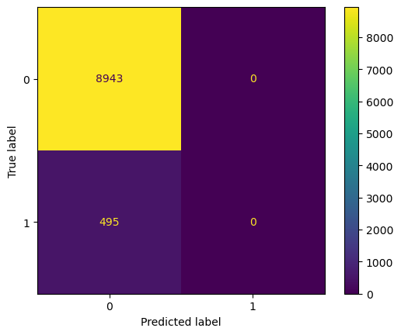
Zero dose no Sampling, balanced vs unbalanced weights
Test

Slide 23
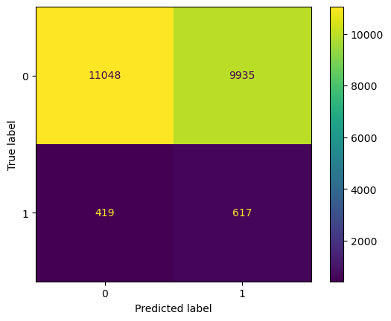
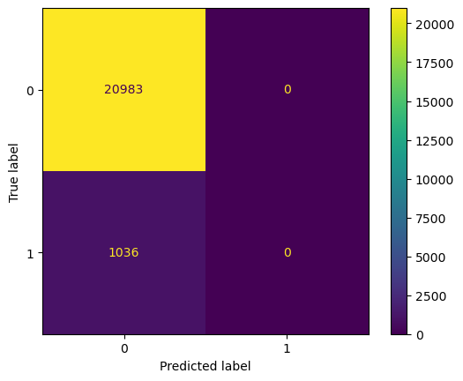
Zero dose no Sampling, balanced vs unbalanced weights
Train

Slide 24

Zero dose Undersampling, balanced vs unbalanced weights
Test

Slide 25
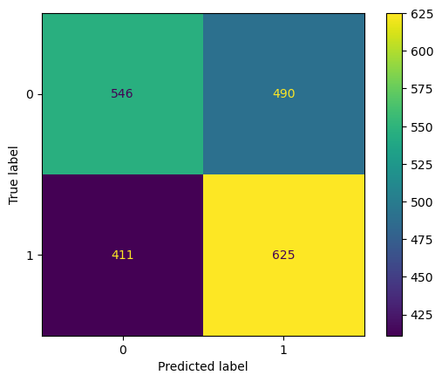
Zero dose Undersampling, balanced vs unbalanced weights
Train

Slide 26

Zero dose Oversampling SMOTE, balanced vs unbalanced weights
Test

Slide 27
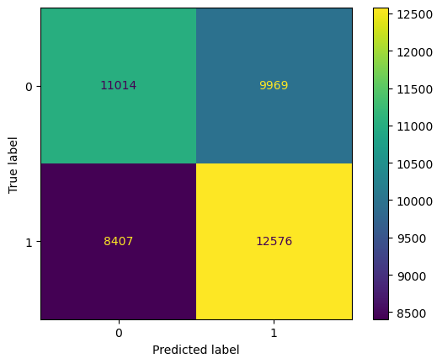
Zero dose Oversampling SMOTE, balanced vs unbalanced weights
Train

Slide 28
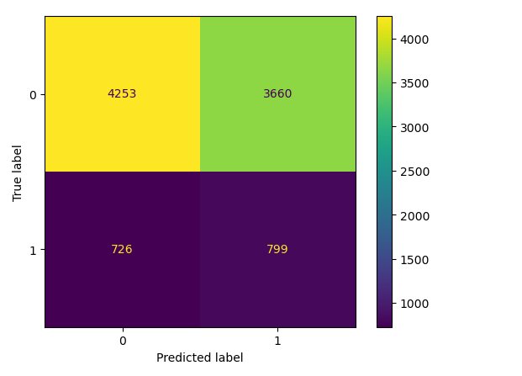
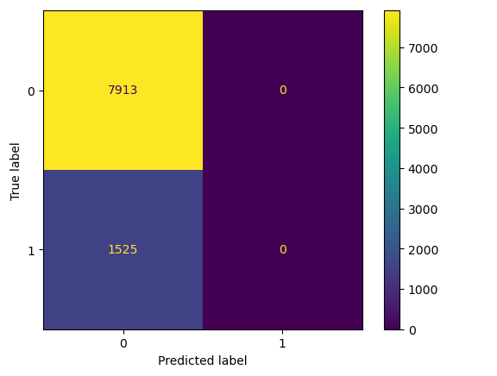
Under vacc no Sampling, balanced vs unbalanced weights
Test

Slide 29
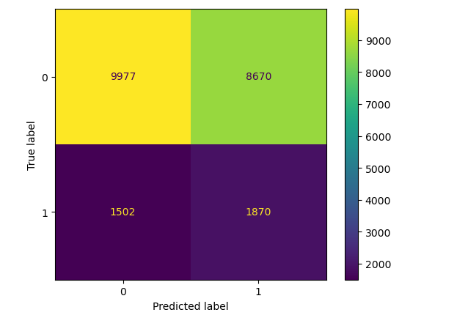
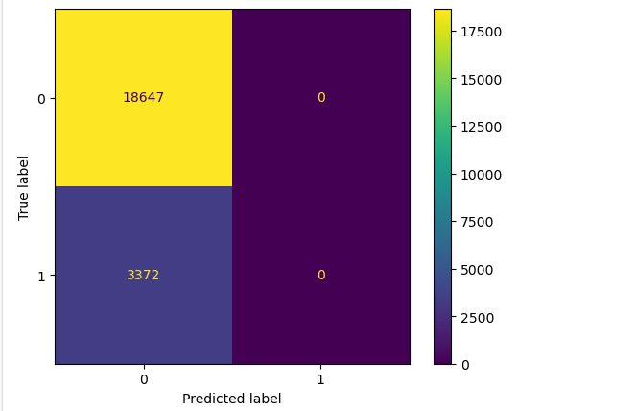
Under vacc no Sampling, balanced vs unbalanced weights
Train

Slide 30
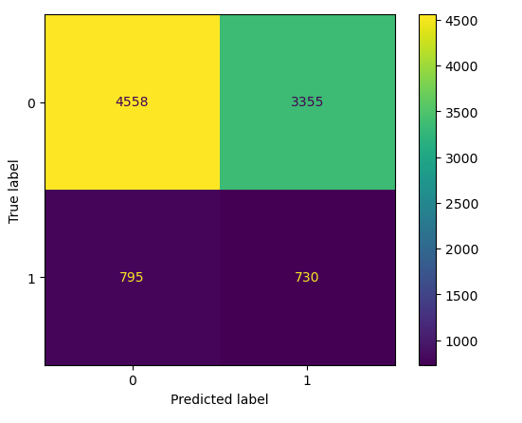

Under vacc Undersampling, balanced vs unbalanced weights
Test

Slide 31
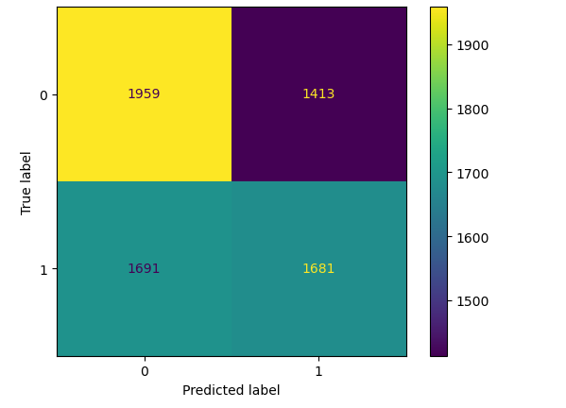
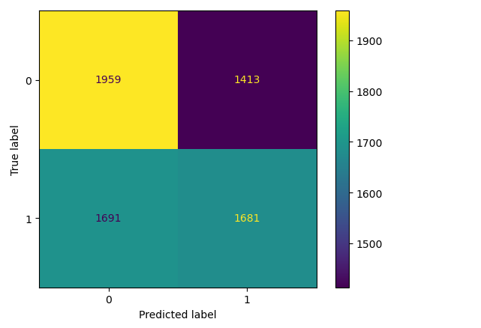
Under vacc Undersampling, balanced vs unbalanced weights
Train

Slide 32

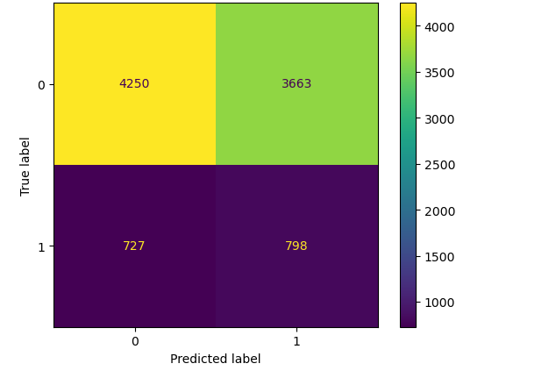
Under vacc Oversampling SMOTE, balanced vs unbalanced weights
Test

Slide 33
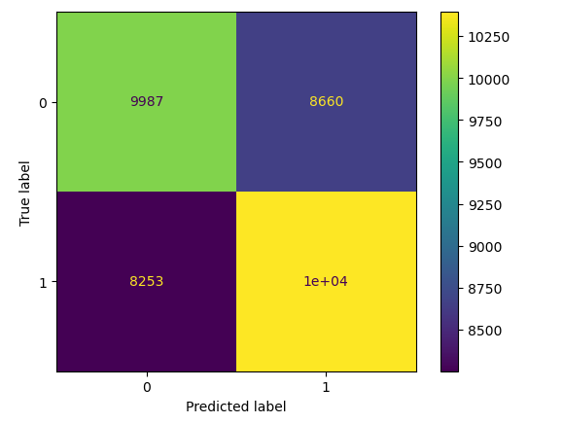
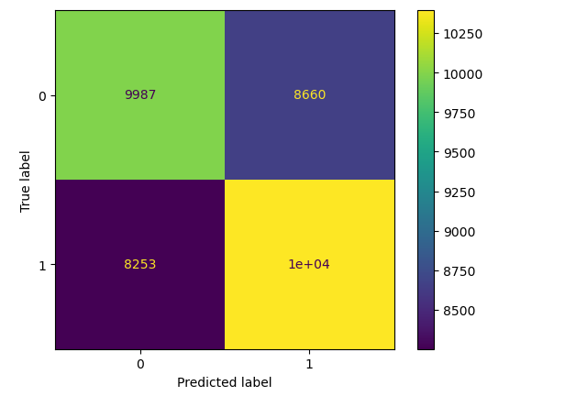
Under vacc Oversampling SMOTE, balanced vs unbalanced weights
Train

Slide 34
Sampling breakdown zero_dose
 | Dataset | Unsampled Train | Unsampled Test | Undersampling Train | Undersampling Test | Oversampling Train | Oversampling Test | Oversampling Train | Oversampling Test
 |  |  |  |  |  |  |  | SMOTE
False Datapoint | 12617 | 8828 | 3789 | 367 | 3789 | 8828 | 3789 | 8828 | 3789
True Datapoint | 520 | 367 | 153 | 367 | 153 | 8828 | 153 | 8828 | 153

Slide 35
Sampling breakdown for under_vaccinated
 | Dataset | Unsampled Train | Unsampled Test | Undersampling Train | Undersampling Test | Oversampling Train | Oversampling Test | Oversampling Train | Oversampling Test
 |  |  |  |  |  |  |  | SMOTE
False Datapoint | 26560 | 18647 | 7913 | 3372 | 7913 | 18647 | 7913 | 18647 | 7913
True Datapoint | 4897 | 3372 | 1525 | 3372 | 1525 | 18647 | 1525 | 18647 | 1525

Slide 36
Variables Definition
I have added all the variables used in the excel sheet linked below, unfortunately I am unable to add the details to the presentation due to size constraints.
Redundant variables (correlation of exactly 1 and -1) have been marked as red, which will be removed from further analyses.
https://docs.google.com/spreadsheets/d/1ypyREMqNoYry7VJ2rSggHw-_NGCYxtGLv-OUZNYyAtI/edit#gid=0

Slide 37
Cramers V >0.1 variables for zero_dose
zero_dose | 1
fully_vac | 0.53
under_vacc | 0.53
Elevation | 0.17
LATNUM | 0.19
LONGNUM | 0.18

Slide 38
Cramers V <0.1 variables for zero dose
zero_dose
impr_ws | 0.02
unimpr_ws | 0.02
basic_drinking_w | 0.02
limited_drinking_w | 0.02
jmp_w8 | 0
jmp_w2 | 0.02
jmp_w5 | 0
jmp_s1 | 0
jmp_s6 | 0.02
jmp_s8 | 0.01
jmp_s7 | 0
jmp_h1 | 0.01
jmp_h2 | 0.01
jmp_h3 | 0.02
wi_combined | 0.04
wi_combined_score | 0.05
wi_ur | 0.06
wi_ur_score | 0.07
kaccha_floor | 0.03
kaccha_roof | 0.01
kaccha_walls | 0.01
all_kaccha_house | 0.03
own_house | 0.01
own_agri_land | 0.02
bpl_card | 0.01
highest_grade_comp | 0.05
bank_acc | 0.02
other_wives | 0.02
mcp_card | 0.06
antenatal_care | 0.05
antenatal_4plus | 0.05
tetanus | 0.04
icds_rec | 0.08
icds_rec_bf | 0.08
w_age_marr | 0.04
caste_le | 0.04
highest_edu_lvl_le | 0.06
w_religion_le | 0.07
w_marital_status_le | 0.01
delivery_place_le | 0.07

Slide 39
Cramers V
Note: The trend remains the same for under vaccinated variables for the previous 2 slides

Slide 40
Zero dose and under vacc proportions
There are 2,761 datapoints where zero dose children are a subset of undervaccinated children.
 | True | False | Empty
Under vacc | 7865 | 35220 | 96
Zero dose | 2761 | 40290 | 130

Slide 42
Zero dose and under vacc proportions
True datapoints are only considered for the below table For proportions, empty values have been ignored
There are 2,761 datapoints where zero dose children are a subset of undervaccinated children.
 | All datapoints | After dropping empty values | Datapoints in dropped rows
Under vacc | 7865 | 4897 | 2968
Zero dose | 2761 | 1531 | 1230
 | All datapoints | After dropping empty values | Datapoints in dropped rows
Under vacc | 18.2% | 15.56% | 25.52%
Zero dose | 6.41% | 4.86% | 10.6%

Slide 43
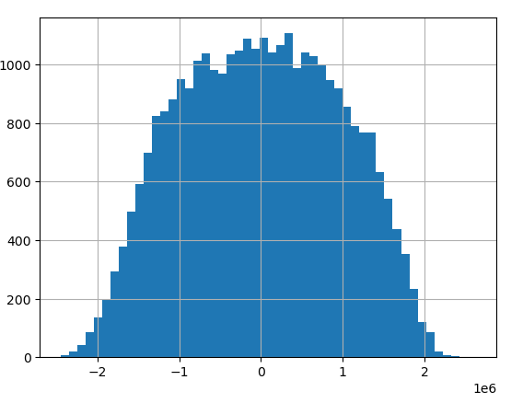
Recoding to binary
Converted wealth index to poor binary
For score, -1 to -2 as poor,
>-2 as very poor?

Slide 44
Comparison while removing geospatial vars
Zero Dose(weight balanced)
Total data points : 43,181 (12-23 years) Non-empty data points : 31,457 12,617
Test/Train | Accuracy | Precision | Recall | F1 | Datapoints
No sampling on True datapoint | 0.53 | 0.06 | 0.56 | 0.11 | 495
No Elevation | 0.53 | 0.06 | 0.59 | 0.11 | 446
No lat | 0.53 | 0.06 | 0.56 | 0.11 | 495
No sampling on True datapoint | 0.53 | 0.06 | 0.60 | 0.11 | 1036
No Elevation | 0.53 | 0.06 | 0.58 | 0.11 | 1098
No lat | 0.53 | 0.06 | 0.60 | 0.11 | 1036
Undersampling on True datapoint | 0.53 | 0.06 | 0.56 | 0.11 | 495
No Elevation | 0.53 | 0.06 | 0.59 | 0.11 | 446
No lat | 0.53 | 0.06 | 0.56 | 0.11 | 495
Undersampling on True datapoint | 0.57 | 0.56 | 0.60 | 0.58 | 1036
No Elevation | 0.55 | 0.55 | 0.58 | 0.56 | 1098
No lat | 0.57 | 0.56 | 0.60 | 0.58 | 1036
Oversampling on True datapoint | 0.53 | 0.06 | 0.56 | 0.11 | 495
No Elevation | 0.54 | 0.06 | 0.60 | 0.11 | 446
No lat | 0.53 | 0.06 | 0.56 | 0.11 | 495
Oversampling on True datapoint | 0.56 | 0.56 | 0.59 | 0.57 | 20983
No Elevation | 0.55 | 0.55 | 0.58 | 0.56 | 21056
No lat | 0.56 | 0.56 | 0.59 | 0.57 | 20983
Oversampling SMOTE on True datapoint | 0.53 | 0.06 | 0.56 | 0.11 | 495
No Elevation | 0.53 | 0.06 | 0.59 | 0.11 | 446
Oversampling SMOTE on True datapoint | 0.56 | 0.56 | 0.60 | 0.58 | 20983
No Elevation | 0.56 | 0.55 | 0.58 | 0.57 | 21056

Slide 47
Zero Dose Updated(weight balanced)
Total data points : 43,181 (12-23 years) Non-empty data points : 28187 26958 False,1229 True
Test/Train | Accuracy | Precision | Recall | F1 | Datapoints
No sampling on True datapoint | 0.90 | 0.30 | 1.00 | 0.46 | 375
No sampling on True datapoint | 0.90 | 0.30 | 1.00 | 0.46 | 854
Undersampling on True datapoint | 0.90 | 0.30 | 1.00 | 0.46 | 375
Undersampling on True datapoint | 0.95 | 0.92 | 1.00 | 0.96 | 854
Oversampling on True datapoint | 0.90 | 0.30 | 1.00 | 0.46 | 375
Oversampling on True datapoint | 0.95 | 0.90 | 1.00 | 0.95 | 18876
Oversampling SMOTE on True datapoint | 0.91 | 0.30 | 0.79 | 0.44 | 375
Oversampling SMOTE on True datapoint | 0.95 | 0.92 | 0.99 | 0.96 | 18876

Slide 48
Zero Dose( No weight balancing)
Total data points : 43,181 (12-23 years) Non-empty data points :
Test/Train | Accuracy | Precision | Recall | F1 | Datapoints
No sampling on True datapoint | 0.95 | 0.36 | 0.03 | 0.05 | 375
No sampling on True datapoint | 0.96 | 0.57 | 0.04 | 0.08 | 854
Undersampling on True datapoint | 0.90 | 0.30 | 1.00 | 0.46 | 375
Undersampling on True datapoint | 0.95 | 0.92 | 1.00 | 0.96 | 854
Oversampling on True datapoint | 0.90 | 0.30 | 1.00 | 0.46 | 375
Oversampling on True datapoint | 0.95 | 0.90 | 1.00 | 0.95 | 18876
Oversampling SMOTE on True datapoint | 0.91 | 0.30 | 0.79 | 0.44 | 375
Oversampling SMOTE on True datapoint | 0.95 | 0.92 | 0.99 | 0.96 | 18876

